Slide 1

CS 52 Bank Project
Group 5: Robin Saacks
Patricia Shatz
Shanyun Wen

Slide 2
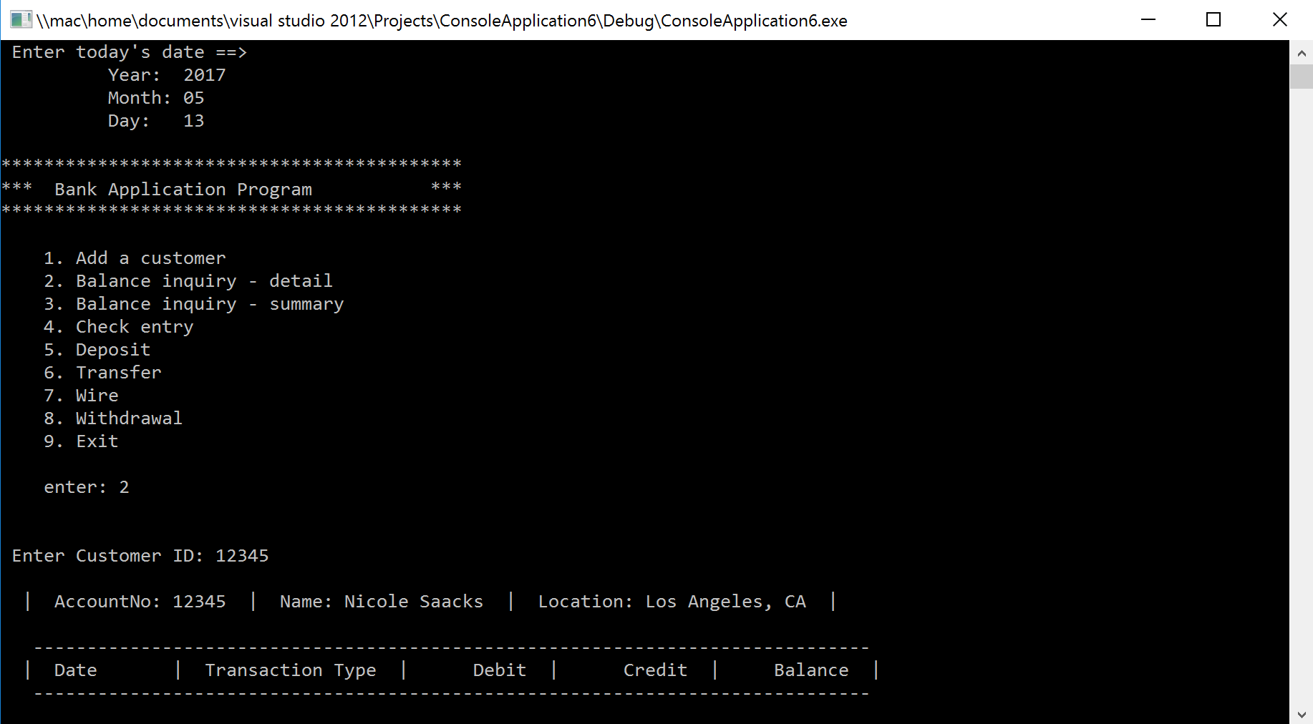

Slide 3
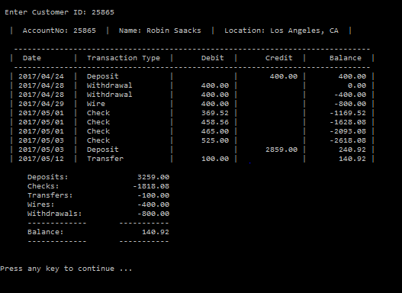

Slide 4
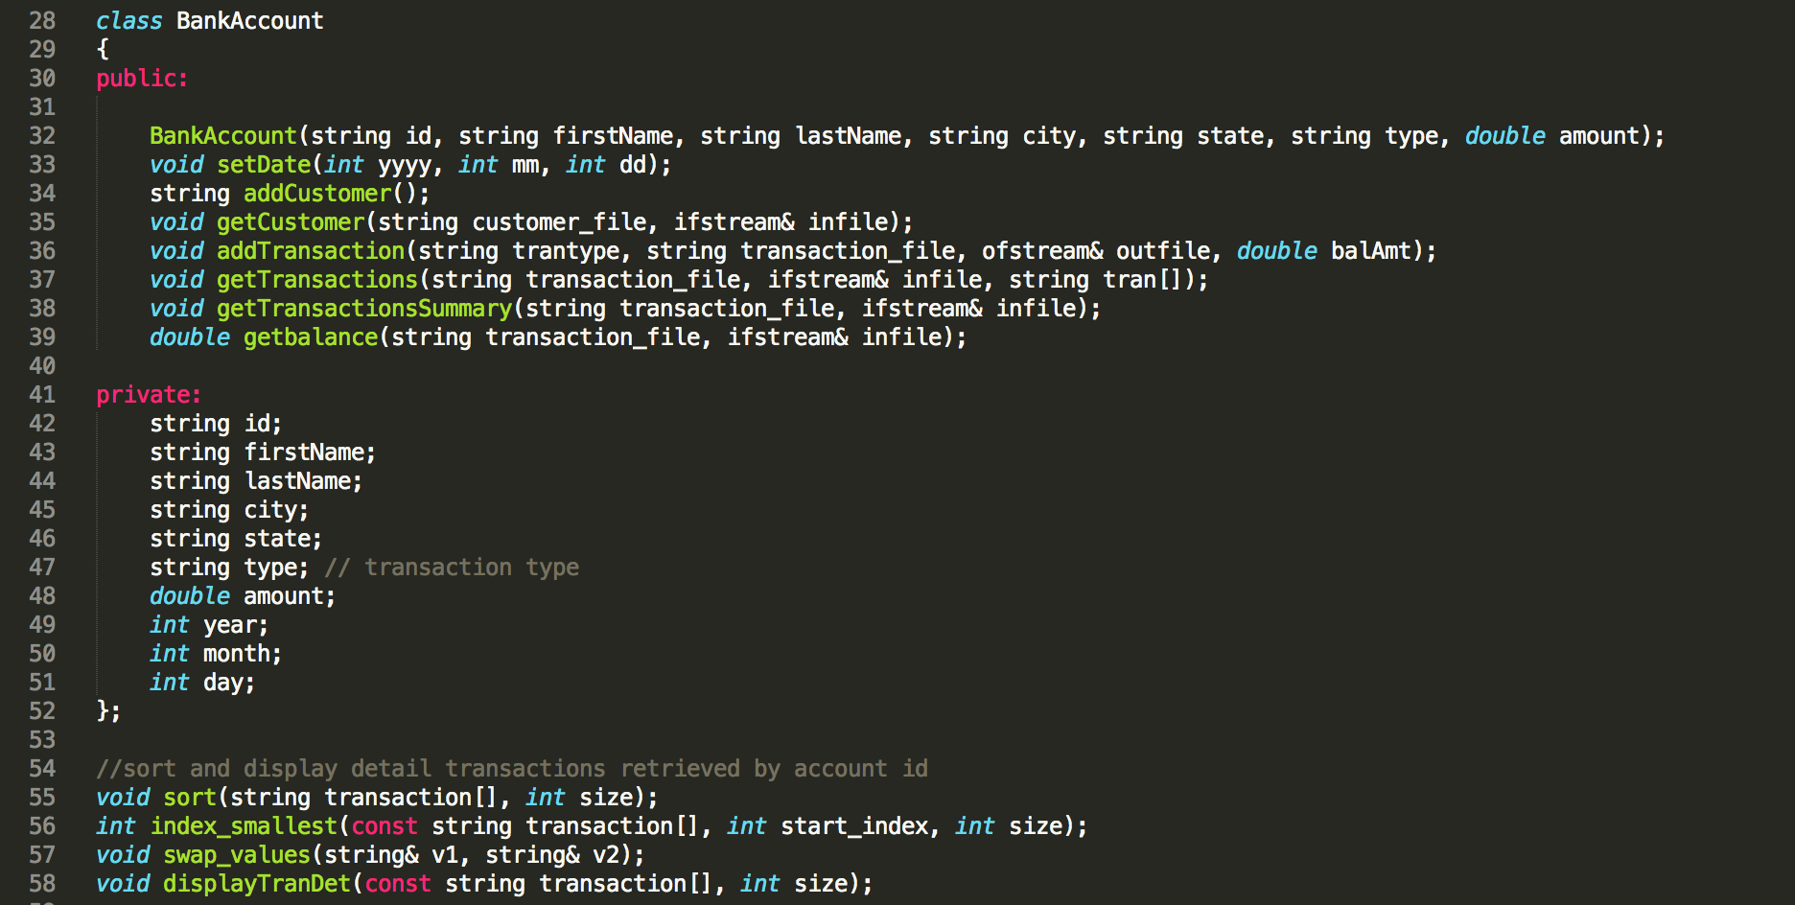
Public/Private Classes and Major Functions

Slide 5
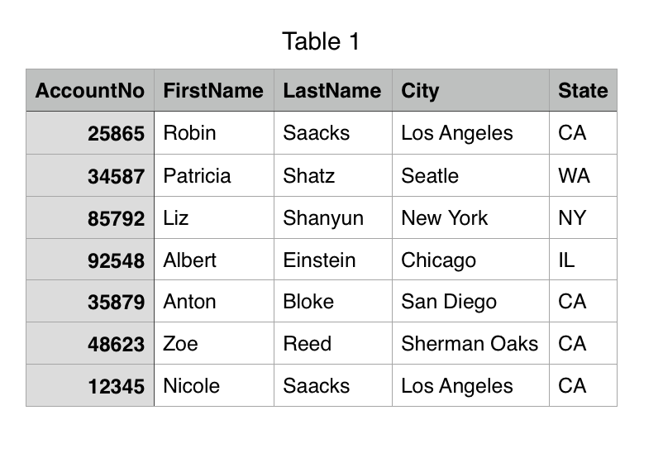
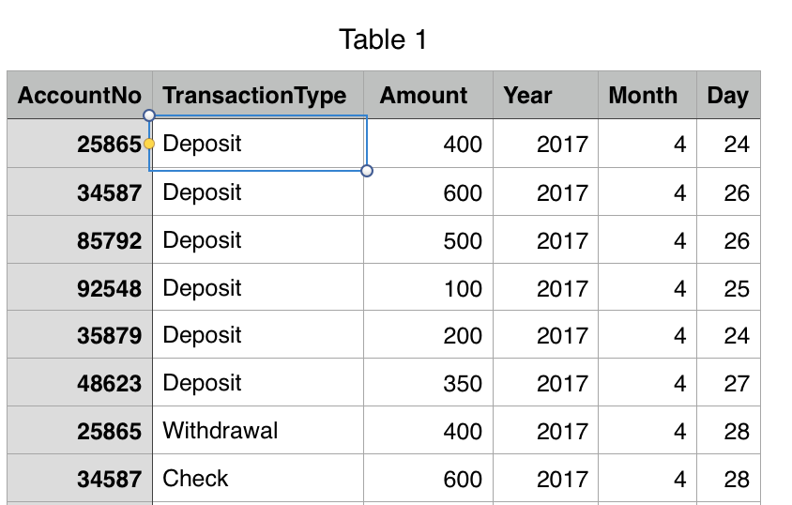
Input/Output Files
Customers.csv
Transactions.csv

Slide 6
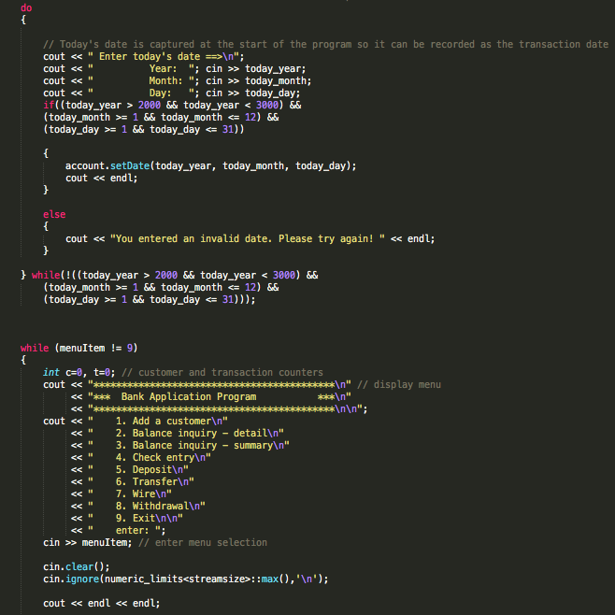

Slide 7
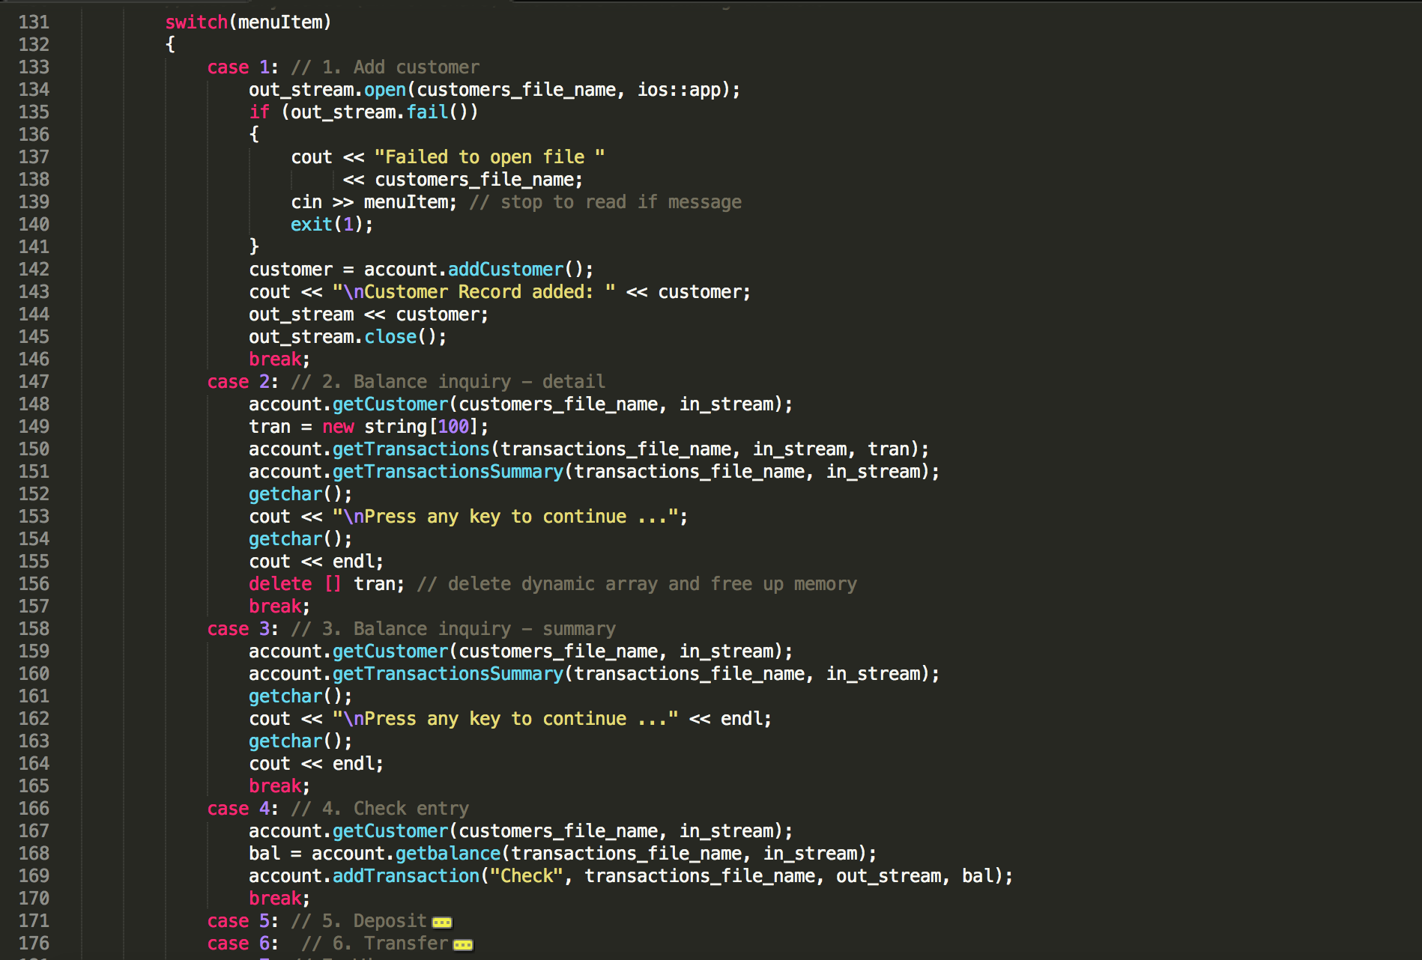
Notes:
Lizzie: the switch menu and it’s functions

Slide 8
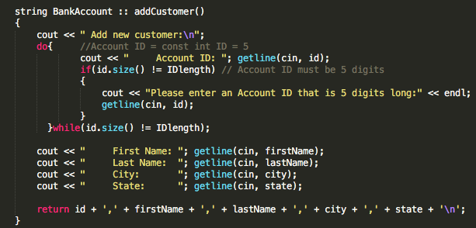

Slide 9
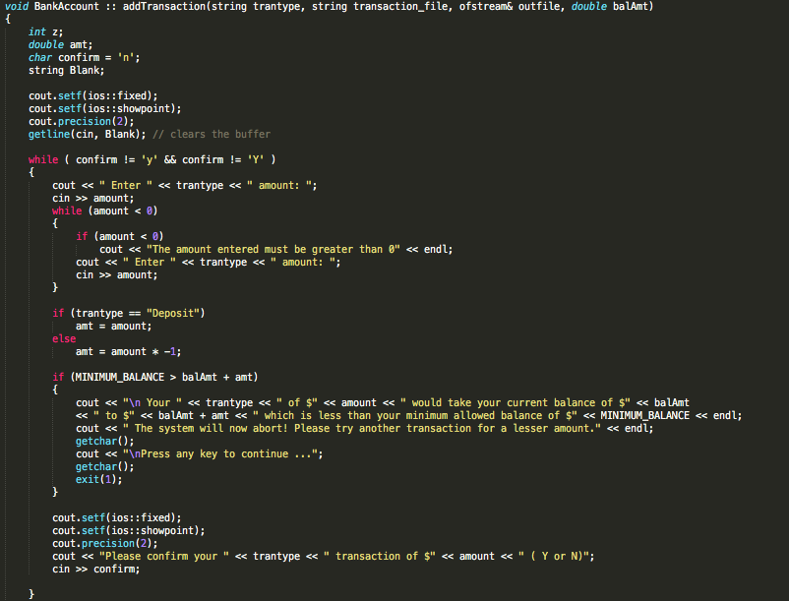

Slide 10
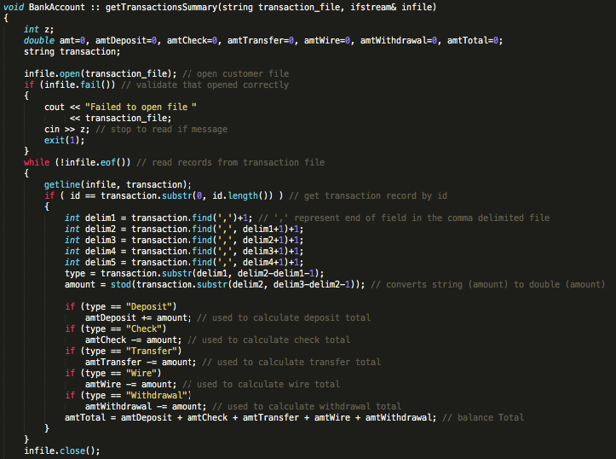

Slide 11
Code Demo

